Slide 1

CNSCC.203 Computer Networks Routing Protocols
Muhammad Azhar Iqbal
azhar.iqbal@lancaster.ac.uk
Credit goes to Dr. Matt Broadbent, Dr. Vasileios Giotsas, and Dr. Wenjuan Yu at SCC for designing module SCC.203.

Slide 2
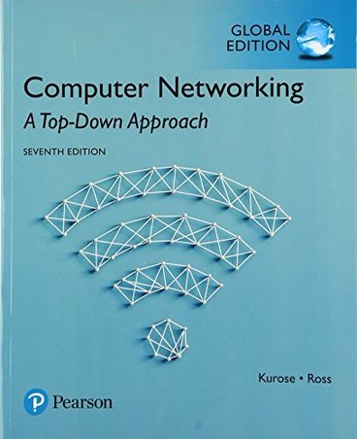

Roadmap
introduction
routing protocols
link state
distance vector
intra-ISP routing: OSPF
routing among ISPs: BGP
Chapter 5.1-5.4

Slide 3
Roadmap
introduction
routing protocols
link state
distance vector
intra-ISP routing: OSPF
routing among ISPs: BGP

Slide 4
Network-layer functions
forwarding: move packets from router’s input to appropriate router output
data plane
转发:将数据包从路由器的输入移动到适当的路由器输出
routing: determine route taken by packets from source to destination
control plane
路由:确定数据包从源到目的所经过的路由
构造网络控制平面的两种方法:
Two approaches to structuring network control plane:
per-router control (traditional)
logically centralized control (software defined networking)
每台路由器控制(传统)
逻辑集中控制(软件定义网络)

Slide 5

Per-router control plane
Individual routing algorithm components in each and every router interact in the control plane
每个路由器中的各个路由算法组件在控制平面中相互作用
Routing
Algorithm
control
plane
data
plane
values in arriving
packet header
0111
1
3
2

Slide 6
Software-Defined Networking (SDN) control plane
Remote controller computes, installs forwarding tables in routers
远程控制器计算并在路由器中安装转发表
Remote Controller
control
plane
CA:控制代理
不能直接相互交互
不参与计算转发表
data
plane
CA
CA
CA
CA
CA
values in arriving
packet header
0111
1
3
2

Slide 7
Roadmap
introduction
routing protocols
link state
distance vector
intra-ISP routing: OSPF
routing among ISPs: BGP

Slide 8


















Routing protocols
路由协议目标:通过路由器网络确定从发送主机到接收主机的“良好”路径
mobile network
Routing protocol goal: determine “good” paths (equivalently, routes), from sending hosts to receiving host, through network of routers
path: sequence of routers packets traverse from given initial source host to final destination host
“good”: least “cost”, “fastest”, “least congested”
routing: a “top-10” networking challenge!
national or global ISP
application
transport
network
link
physical
network
link
physical
network
link
physical
network
link
physical
network
link
physical
network
link
physical
datacenter
network
application
transport
network
link
physical
enterprise
network

Slide 9
Graph abstraction: link costs
5
c_{a,b}: cost of direct link connecting a and b
e.g., c_{w,z} = 5, c_{u,z} = ∞
cost defined by network operator: could always be 1, or inversely related to bandwidth, or inversely related to congestion
v
3
w
2
5
u
2
1
z
3
1
2
x
y
1
graph: G = (N,E)
N: set of routers = { u, v, w, x, y, z }
E: set of links ={ (u,v), (u,x), (v,x), (v,w), (x,w), (x,y), (w,y), (w,z), (y,z) }
Q: What is the least-cost path between u and z ?
routing algorithm: algorithm that finds that least cost path

Slide 10
Routing algorithm classification
路由算法分类
global: all routers have complete topology, link cost info
“link state” algorithms
所有路由器都有完整的拓扑结构，链路开销信息
链路状态算法
dynamic: routes change more quickly
periodic updates or in response to link cost changes
How fast do routes change?
static: routes change slowly over time
分散的
迭代的计算过程，与邻居交换信息
decentralized: iterative process of computation, exchange of info with neighbors
routers initially only know link costs to attached neighbors
“distance vector” algorithms
定期更新或响应链接成本的变化
距离向量算法
global or decentralized information?

Slide 11
Routing Overview
Algorithms
Dijkstra’s algorithm—single source shortest path
Bellman-Ford—all pairs shortest paths to destination
Approaches
Link state routing (Dijkstra’s algorithm at each node)
Distance vector routing (based on Bellman-Ford)
Protocols
OSPF (Link State Routing Protocol)
RIP (Distance Vector Routing Protocol)
单源最短路径
所有对到目的地的最短路径

Slide 12
Roadmap
introduction
routing protocols
link state
distance vector
intra-ISP routing: OSPF
routing among ISPs: BGP

Slide 13
Dijkstra’s link-state routing algorithm
centralized: network topology, link costs known to all nodes
accomplished via “link state broadcast”
all nodes have same info
computes least cost paths from one node (“source”) to all other nodes
gives forwarding table for that node
iterative: after k iterations, know least cost path to k destinations
notation
u: source node
c_{x,y}: direct link cost from node x to y; = ∞ if not direct neighbors
D(v): current estimate of cost of least-cost-path from source to destination v
p(v): predecessor node along path from source to v
N': set of nodes whose least-cost-path definitively known

Slide 14
Dijkstra’s link-state routing algorithm
1 Initialization:
2 N' = {u} /* compute least cost path from u to all other nodes */
3 for all nodes v
4 if v adjacent to u /* u initially knows direct-path-cost only to direct neighbors */
5 then D(v) = c_{u,v} /* but may not be minimum cost! */
6 else D(v) = ∞
7
8 Loop
9
10
11
12
13
14
15 until all nodes are in N'
find w not in N' such that D(w) is a minimum
add w to N'
update D(v) for all v adjacent to w and not in N' :
D(v) = min ( D(v), D(w) + c_{w,v} )
/* new least-path-cost to v is either old least-cost-path to v or known
least-cost-path to w plus direct-cost from w to v */

Slide 15
Dijkstra’s algorithm: an example
v
w
x
y
z
Step
0
1
2
3
4
5
N'
D(v),p(v)
D(w),p(w)
D(x),p(x)
D(y),p(y)
D(z),p(z)
u
2,u
5,u
1,u
∞
∞
ux
2,u
4,x
2,x
∞
uxy
2,u
3,y
4,y
uxyv
3,y
4,y
uxyvw
4,y
uxyvwz
Initialization (step 0): For all a: if a adjacent to then D(a) = c_{u,a}
5
find a not in N' such that D(a) is a minimum
add a to N'
update D(b) for all b adjacent to a and not in N' :
D(b) = min ( D(b), D(a) + c_{a,b} )
v
3
w
2
5
u
2
1
z
3
1
2
x
y
1

Slide 16
Dijkstra’s algorithm: an example
5
v
3
w
2
5
u
2
1
z
3
1
2
x
y
1
resulting least-cost-path tree from u:
resulting forwarding table in u:
v
w
destination
outgoing link
v
x
y
w
z
(u,v)
(u,x)
(u,x)
(u,x)
(u,x)
route from u to v directly
u
z
x
route from u to all other destinations via x
y

Slide 17
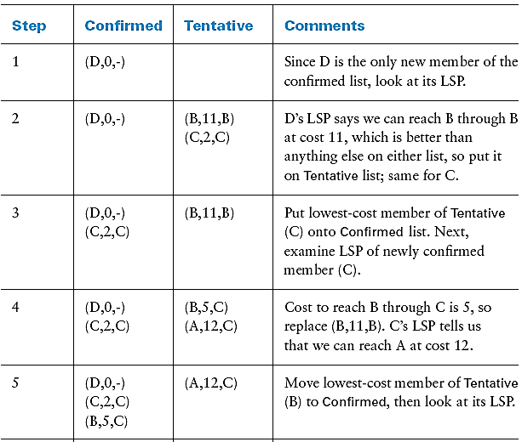
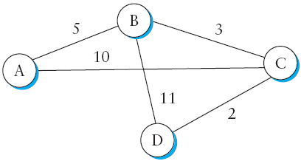
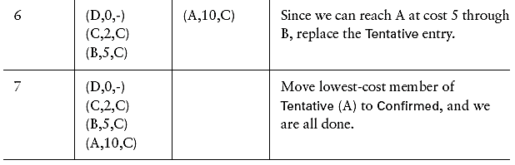
Link-State Routing Example

Slide 18
Dijkstra’s algorithm: discussion
algorithm complexity: n nodes
each of n iteration: need to check all nodes, w, not in N’
n(n+1)/2 comparisons: O(n²) complexity
more efficient implementations possible: O(nlogn)
message complexity: n nodes, E links
O(nE) messages sent

Slide 19
Dijkstra’s algorithm: oscillations possible
当链路成本取决于交通量时，路由振荡是可能的
when link costs depend on traffic volume, route oscillations possible
sample scenario:
routing to destination w, traffic entering at x, y, v with rates 1, e (<1), 1
link costs are directional, and volume-dependent
w
w
w
w
1
1+e
2+e
0
0
2+e
2+e
0
z
x
z
1
x
z
x
z
x
0
0
1+e
0
0
1+e
1
1
0
e
1
0
y
0
1
1
1
y
1+e
1
1
0
0
1
y
1
y
e
e
e
e
given these costs,
find new routing….
resulting in new costs
given these costs,
find new routing….
resulting in new costs
given these costs,
find new routing….
resulting in new costs
initially

